Slide 1


Slide 2
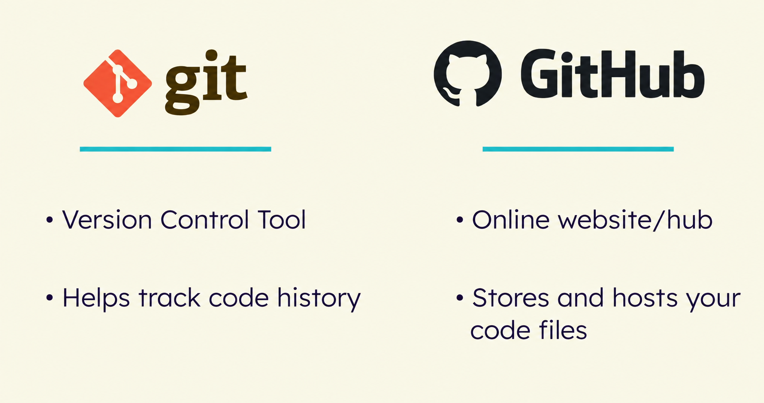

Slide 3
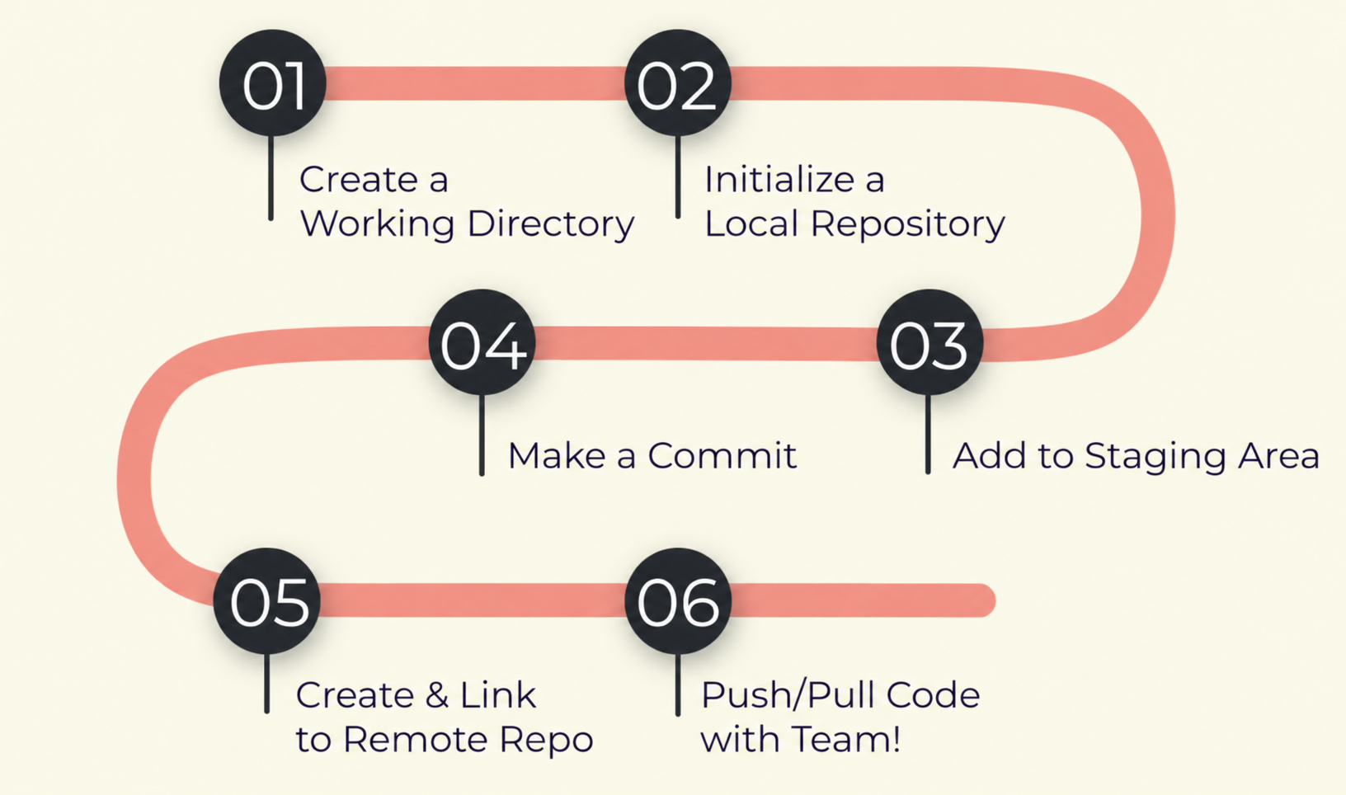

Slide 4
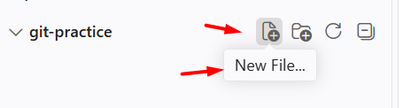
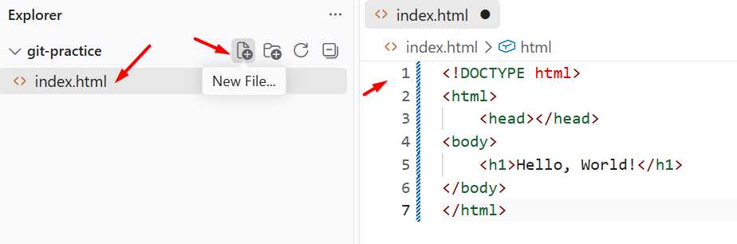

How to Create a Working Directory
Name: Folder - Git-Practice
Step #1: Create a New File i.e. index.html
Step#2: Add some code
U means untracked
What is a Working Directory?
Where your project lives on your computer.
Your Playground to create, modifying and adding code.

Slide 5
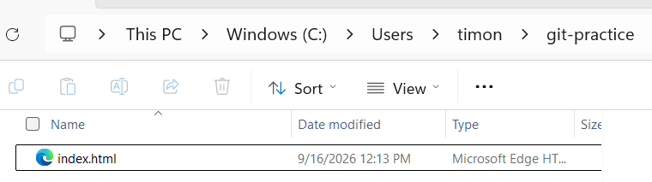
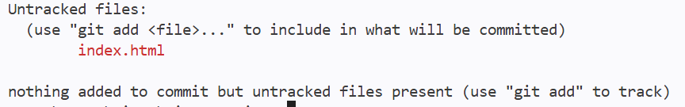
How to Initialize a Local Repository
Step #1: git status – Shows an error because the file is NOT a Git Project
Step #2: git init
NOTE: At this point you have created a Staging Area and a Local Repository
Find your Local Repository on your computer
This PC > Windows (C:) > Users > Timon > git practice
Step #3: git status – Shows a file ready to commit

Slide 6
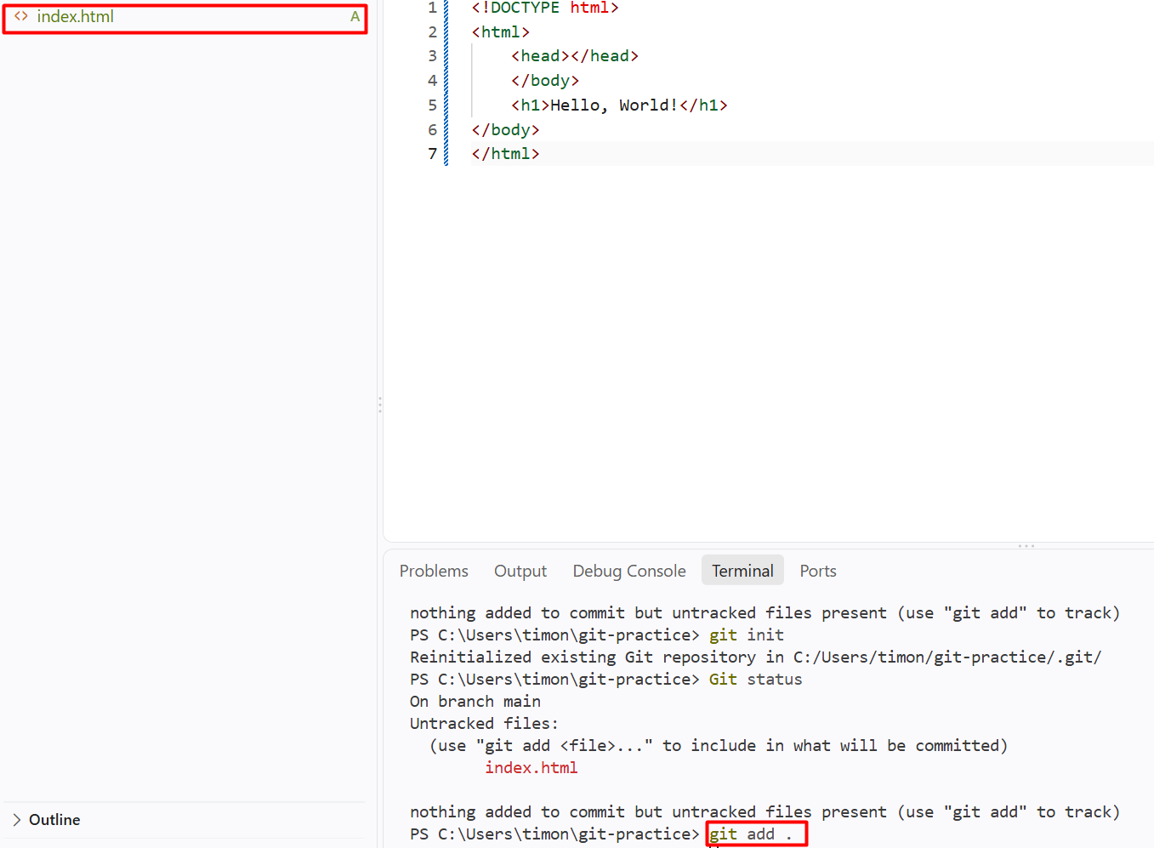
How to Add files to Staging Area
Step #1: git add .
Note: . Means the current directory – it will add all files untracked
Step #2: git status
Now the file is added to the Staging area
A means Added.
Git is now tracking index.html, and the file is STAGED —ready to be committed.

Slide 7
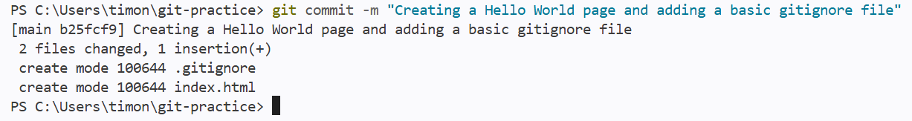
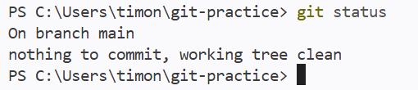
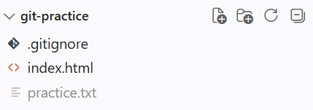
How to Make a Commit
Step #1:
git commit –m “Creating a World World and adding a basic gitignore file”
Step #2: git status
NOTE:
This means nothing is in the Staging Area that needs to be committed

Slide 8
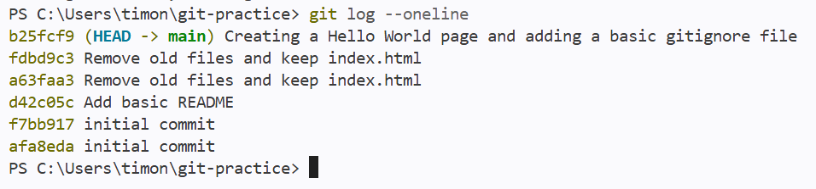
How to see what is Committed?
Step #1:
git log –oneline
NOTE:
Now you have moved everything from the Staging Area to the Local Repository

Slide 9
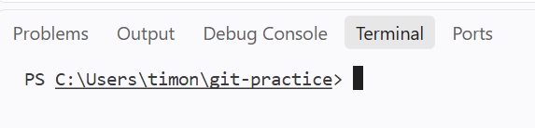
How to Clear the Window in Visual Studio
Step #1:
clear + enter

Slide 10
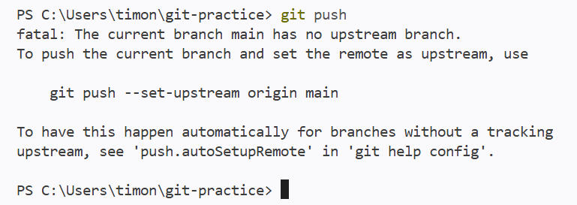
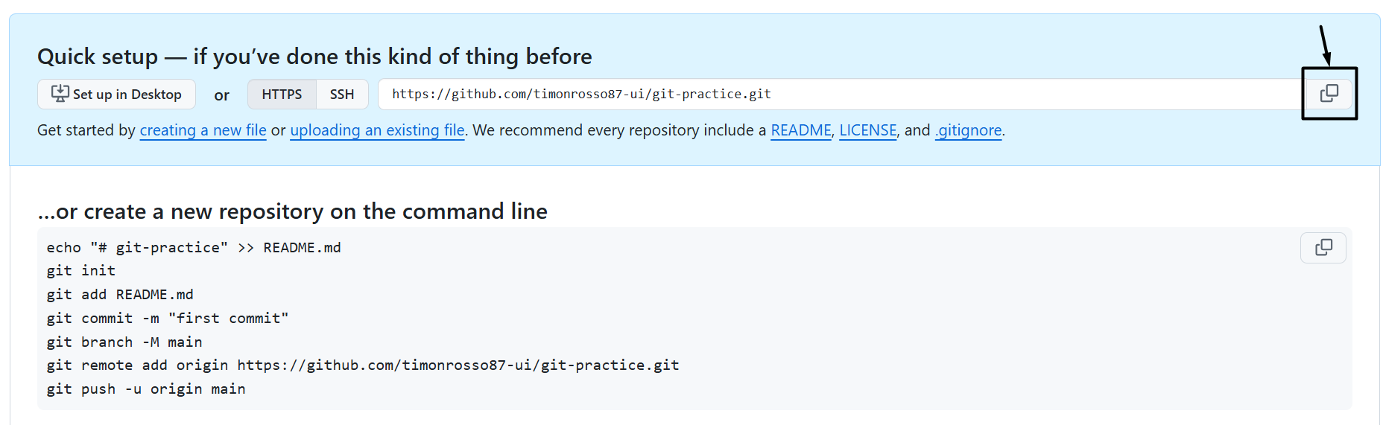
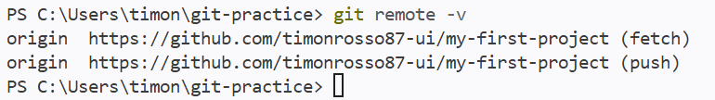
How to move from Local Repository to the Remote Repository
Step #1: Git push
Note: You need to create a destination to push your code to.
You need to link it to your GitHub .com
Step #2: Copy the URL from GitHub when you
create A Repository .
i.e. https://github.com/timonrosso87-ui/git-practice.git
Step #3: In VS Code –
Git remote add origin URL
git remote origin https://github.com/timonrosso87-ui/git-practice.git
Step #4: git remote -v
NOTE:
Shows which online GitHub repository your local folder is connected to.

Slide 11
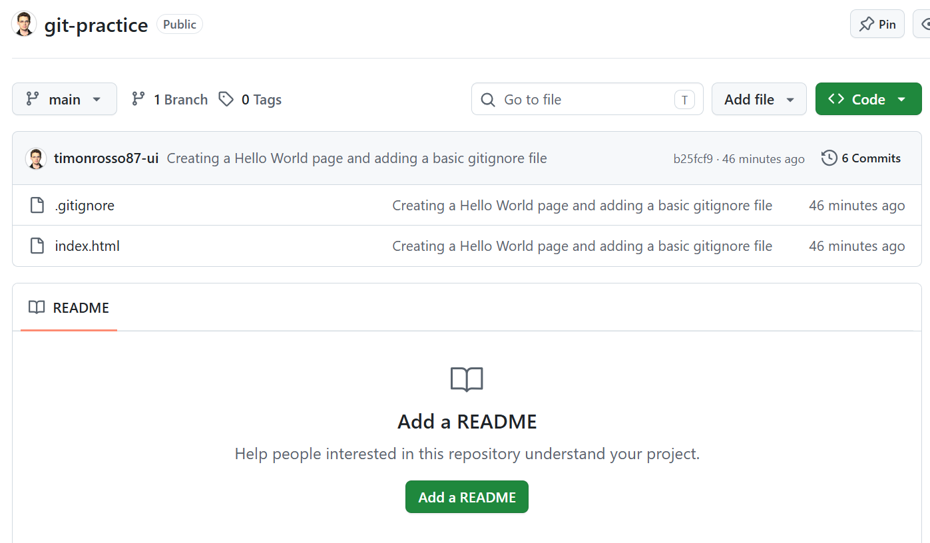
How to PUSH to Main Repository
Step #1: git push --set-upstream origin main
Step #2: Refresh GitHub.com and you’ll see the Repository
NOTE:
These two files are now pushed
onto the Remote Repository
Anybody with the URL
Can see the Commits and Files
You can click on Commits to see
The Logged actions
NOTE:
Shows which online GitHub repository your local folder is connected to.

Slide 12
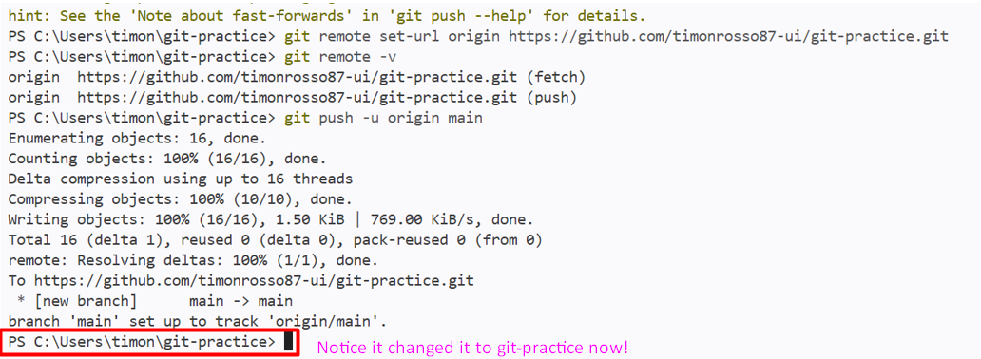
How to move PUSH to Sub Branches
There is a Main Branch and Sub Branches in GitHub.com
Sometimes you want to push the code to a sub branch…
Step #1: git remote set-url origin https://github.com/timonrosso87-ui/git-practice.git
Step #2: git remote –v
Step #3: git push -u origin main

Slide 13
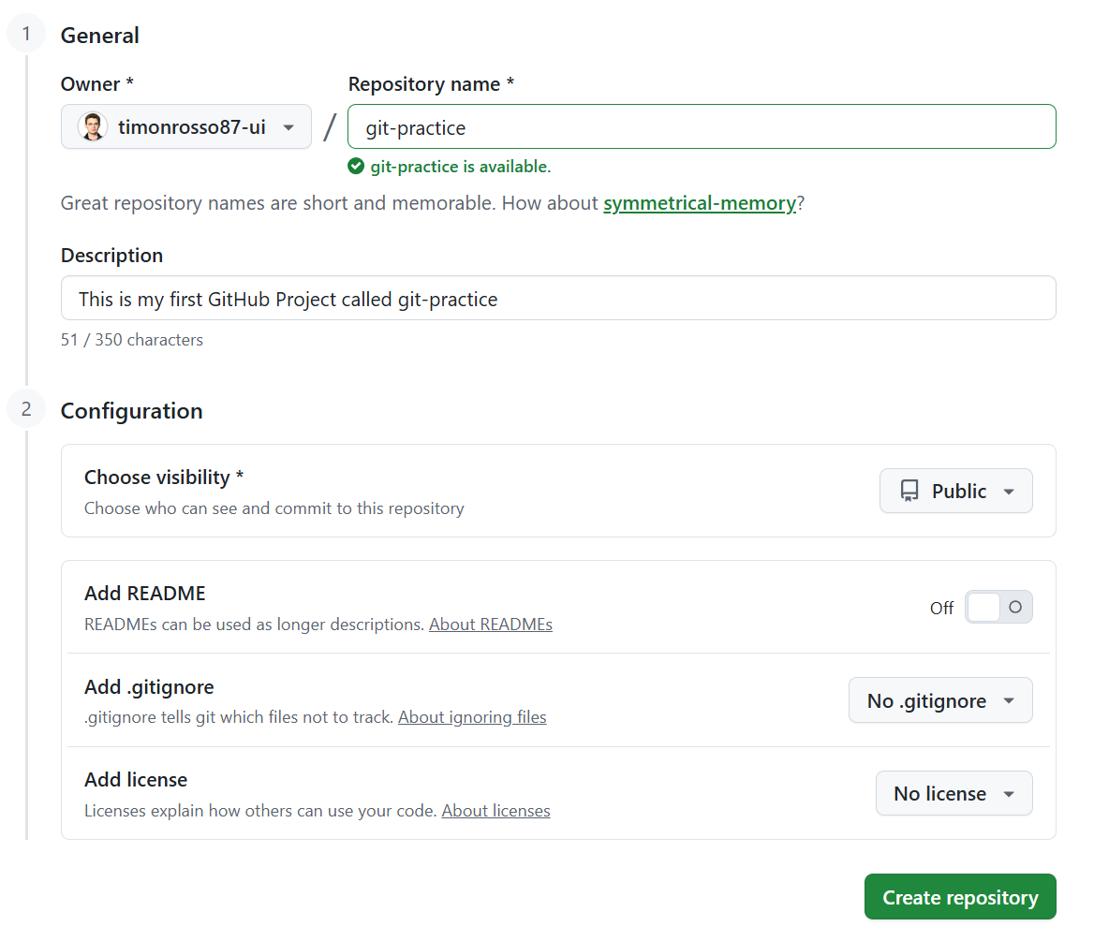
How to Create and Link a Remote Respository
Step #1: Go to GitHub.com and log in
Step #2: Create a New Repository
NOTE:
We will add our own ReadMe
We have created our Own gitignore file
Licence – Wants to explain how to use the code
For commercial purposes etc…

Slide 14
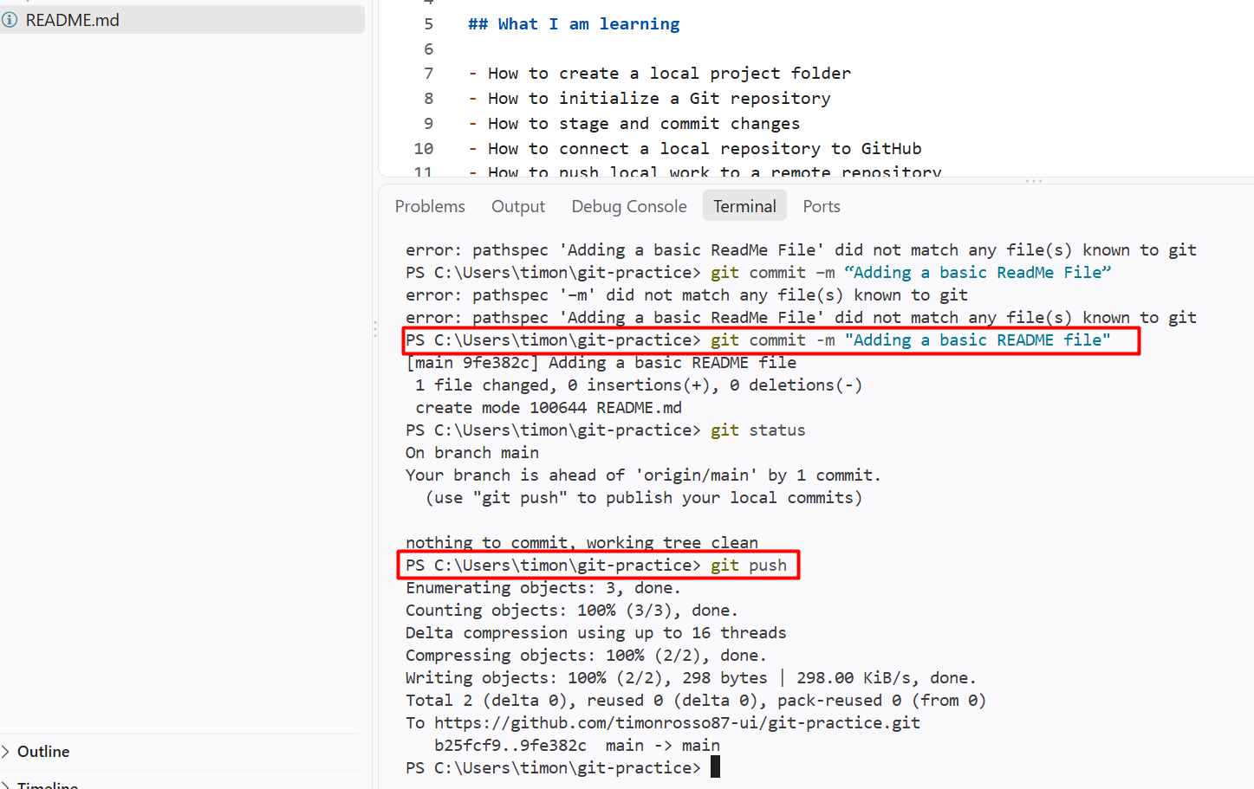
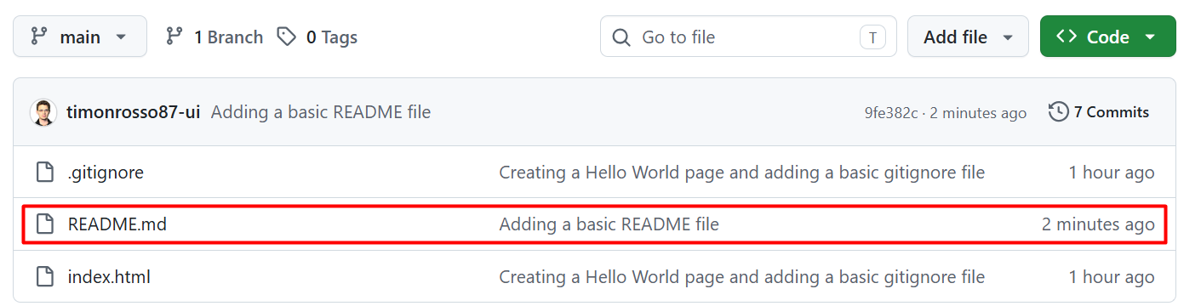
How to Add A ReadMe File
Step #1: Add File README.md
Step #2: git status
Step #3: git add .
Step #4: git commit -m “Adding a basic ReadMe File”
Step #5: git push
Step #6: Refresh and ReadMe is added in Remote Repository
NOTE: Make sure you use a HYPHEN and not a LONG DASH

Slide 15
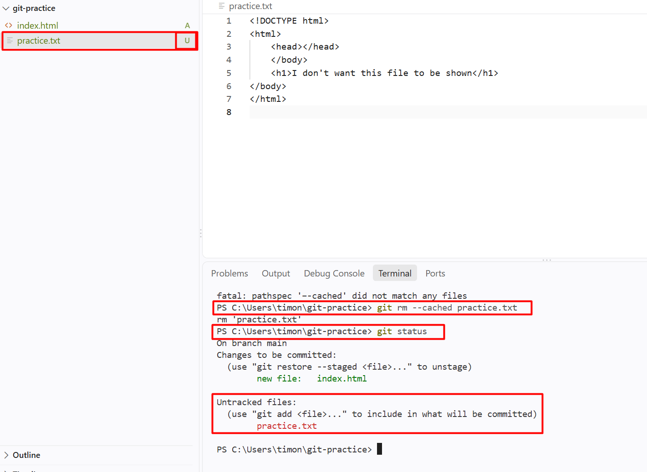
How to Unstage a File
Step #1: git rm --cached practice.txt
Step #2: git status

Slide 16
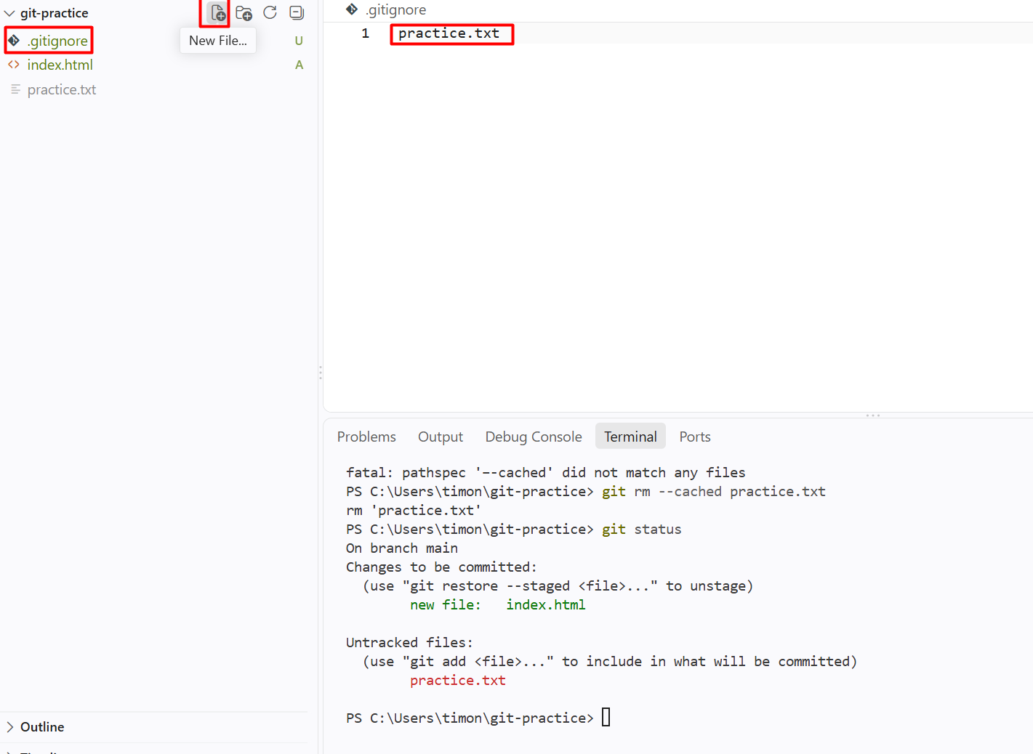

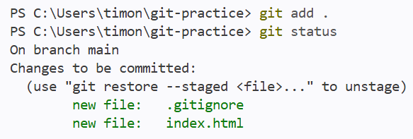

How to Ignore a File
Step #1: Create a New File .gitignore
Step #2: Under – Type the file you want to ignore i.e. practice.txt
Step #3: git status
Step #4: git add .
(to add .gitignore)
NOTE:
All files listed in .gitignore
should be ignored
NOTE:
Now in Grey Practice.txt
Is being ignored!

Slide 17
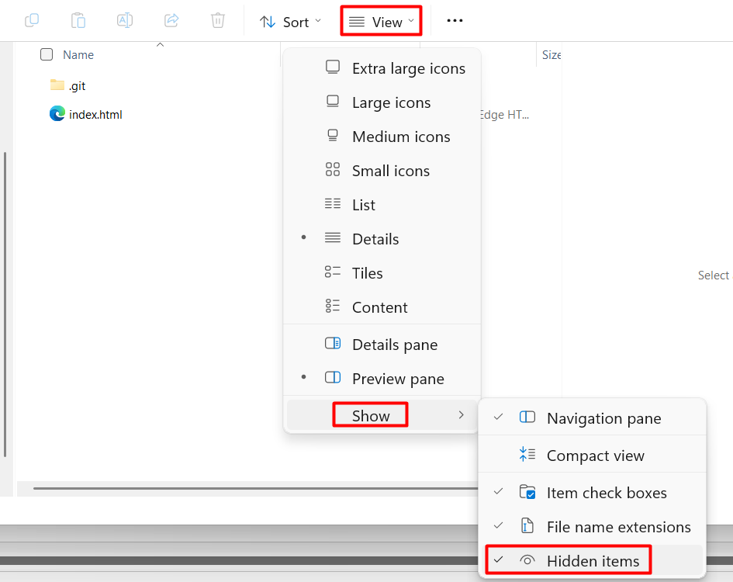
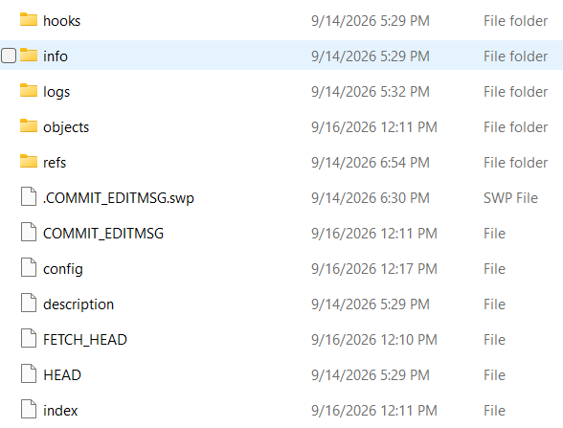
How to Show Hidden Files
Step #1: Computer – Local Repository – Git Project
This PC > Windows (C:) > Users > Timon > git practice
Step #2: View – Show – Hidden items
Inside the hidden files are files – Metadata used by Git
Used to track the history and any code changes

Slide 18

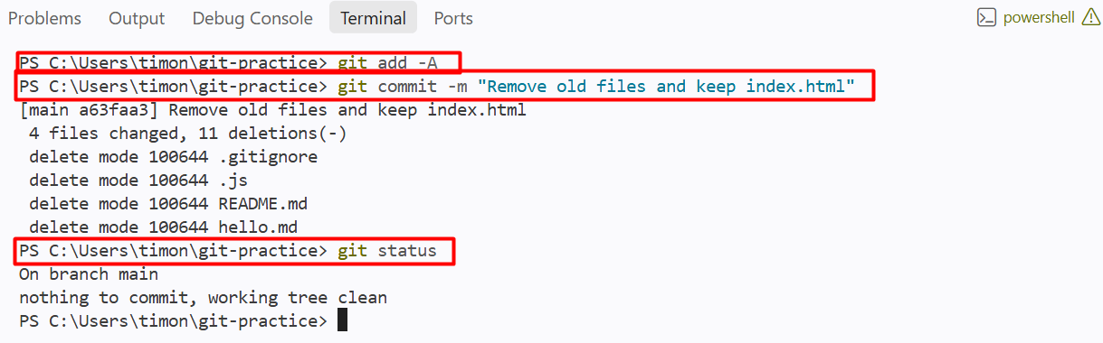
How to Delete Previous Tracked Files
Step #1: POWERSHELL: git add –A
Step #2: git commit -m "Remove old files and keep index.html“
Step #3: git status
Step #4: git ls-files - Confirm only index.html shows.
Step #5:

Slide 19
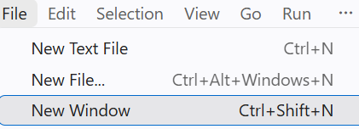
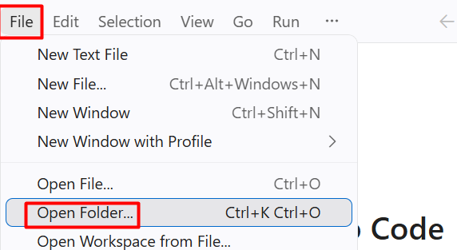

How to Create a New Folder and Run the Terminal
Step #1: Create a Folder – “team-mate-git-practice” on your computer
e.g. C:\Users\timon\git-teammate
Step #2: In VS: File – New Window.
Step #3: File – Open Folder - C:\Users\timon\git-teammate
Step #4: Terminal – New Terminal – Confirm it shows C:\Users\timon\git-teammate

Slide 20
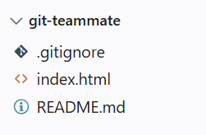
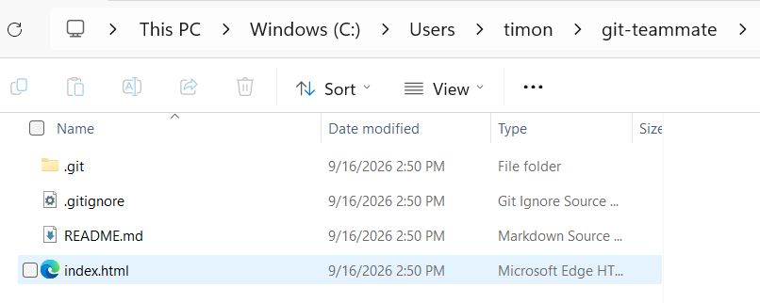
How to Clone Remote Repository
Step #1: In the NEW FOLDER
Step #2: git clone “URL”
git clone https://github.com/timonrosso87-ui/git-practice.git .
NOTE: git clone is only for cloning for the FIRST TIME ONLY
If you want the NEW data you need to PULL it

Slide 21
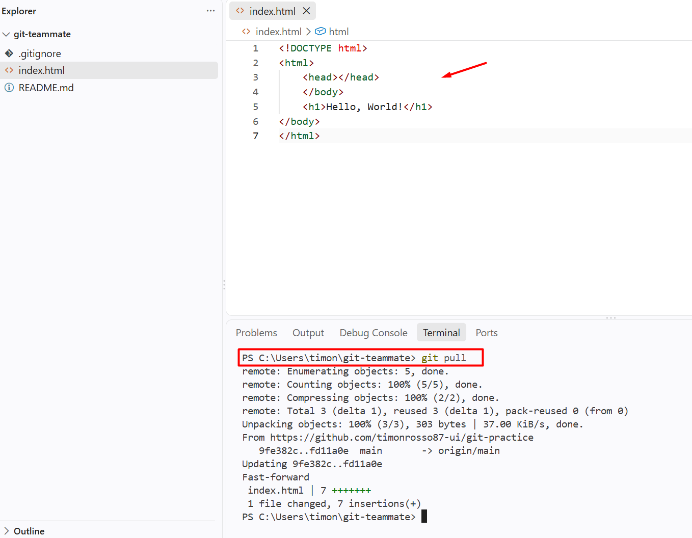
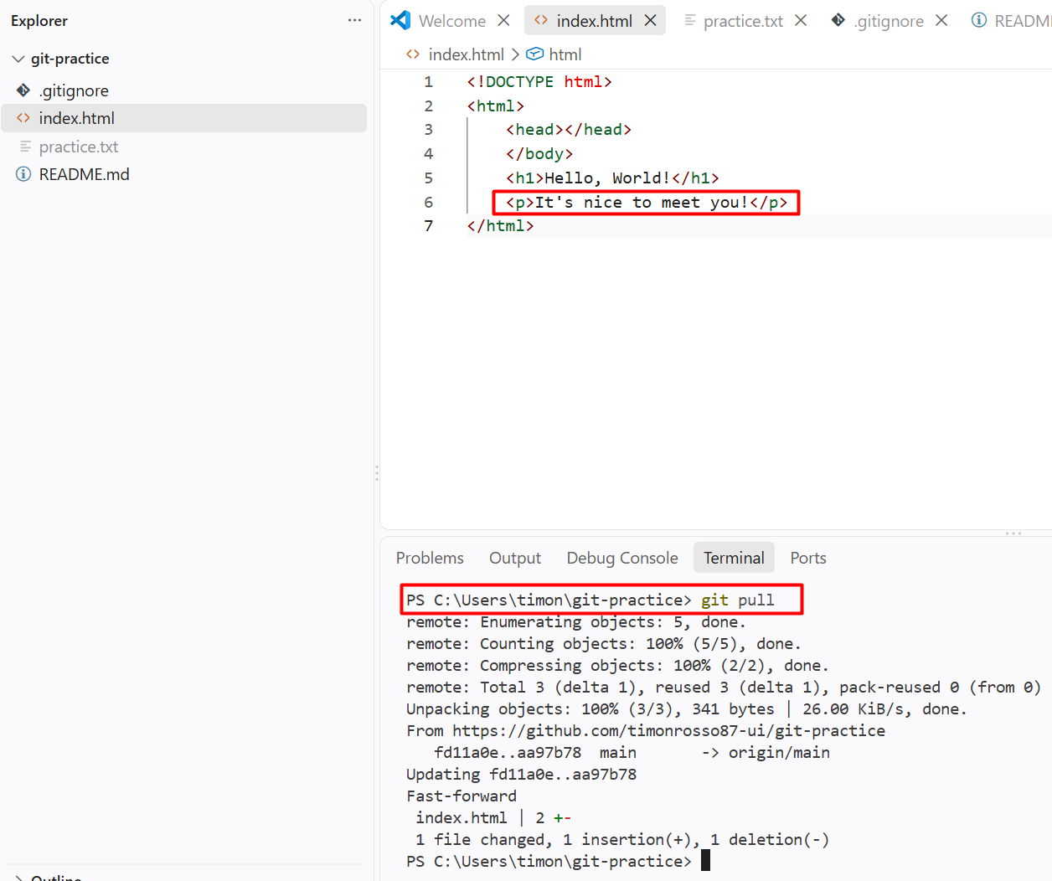
How to Pull New Data from Repository
Step #1: Make sure the Repository is first Cloned (Only once)
Step #2: git pull
NOTE: This updates everything

Slide 22
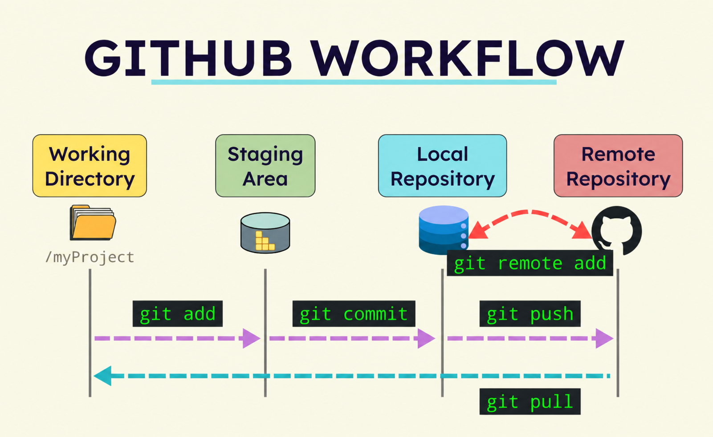
LESSONS LEARNT

Slide 23
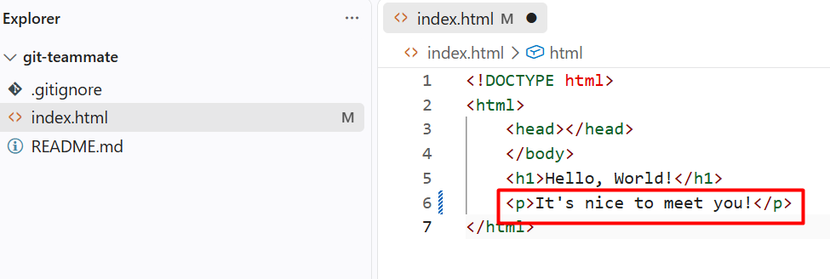
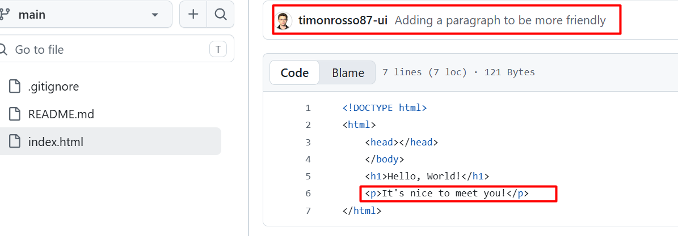
How to Modify from other folder to Main folder
Step #1: Make your change – Save Changes Ctrl+S
m = Modified
Step #2: git add .
Step #3: git commit -m "Adding a paragraph to be more friendly“
Step #4: git push
Step #5: Refresh browser
See change

Slide 24
HOW TO add Powerpoint Presentation to GitHub
Step #1: Name a folder on your computer “Presentations”
Step #2: Copy the PowerPoint presentation into the folder
Step #3:

Slide 25
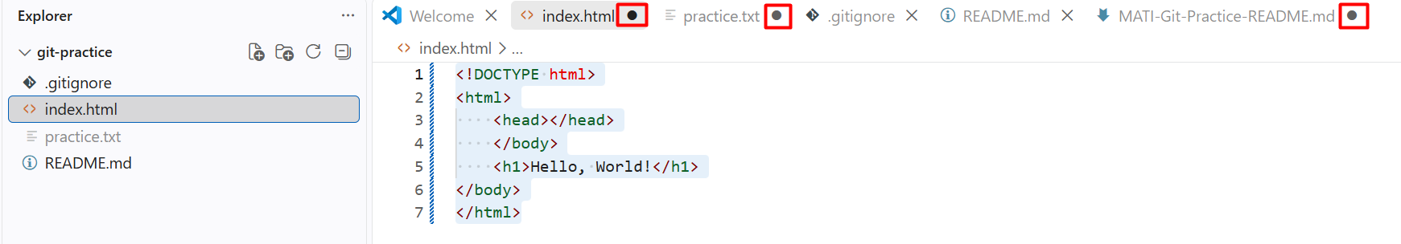
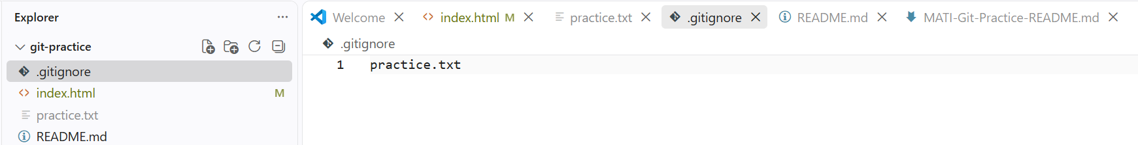
How to Save Changes and Update Repo
NOTICE: There is a Black Dot in the files which need saving
Step #1: Press each file In VS Code - Press Ctrl+ S or File SAVE All
Step #2: git status
Step #3: git add .
Step #4: git commit -m "Update website files“
Step #5: git push

